Slide 1

A Combinatorial Algorithm for Strong Implementation of Social Choice Functions
Clemens Thielen Stephan Westphal
3rd International Workshop on Computational Social Choice
15 September 2010
thielen@mathematik.uni-kl.de

Slide 2
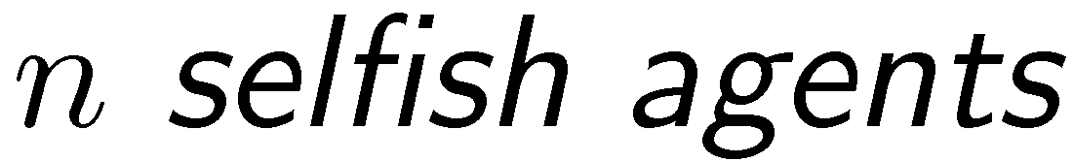
Problem Definition
Social choice setting with private information:
Notes:
In this talk: The objective function will always be weighted sum of completion times.

Slide 3
Problem Definition (2)
We saw (previous talk):
Notes:
In this talk: The objective function will always be weighted sum of completion times.

Slide 4
Our Results
Notes:
In this talk: The objective function will always be weighted sum of completion times.

Slide 5
System of Inequalities
Implementation of a social choice function :
Weak Implementation
Strong Implementation
Notes:
In this talk: The objective function will always be weighted sum of completion times.

Slide 6
Node Potential Interpretation
System can be interpreted as finding a node potential:
constant
constant
Notes:
In this talk: The objective function will always be weighted sum of completion times.

Slide 7
Characterization (Weak Implementation)
Theorem:[Gui et al. 2005]
Notes:
In this talk: The objective function will always be weighted sum of completion times.

Slide 8
Characterization (Strong Implementation)
Theorem:[this paper]
Notes:
In this talk: The objective function will always be weighted sum of completion times.

Slide 9
The Algorithm
For weak implementation:
For strong implementation:
Strict inequalities
in the system must be fullfilled.
Notes:
In this talk: The objective function will always be weighted sum of completion times.

Slide 10
Perturbation of Node Potentials
Notes:
In this talk: The objective function will always be weighted sum of completion times.

Slide 11
Perturbation in Graph G_{i}
Slack of arc (x,x´)
Slack of incoming arcs becomes positive
Notes:
In this talk: The objective function will always be weighted sum of completion times.

Slide 12

Finding the Node x
You shrink it!

Slide 13
Summary of Results

Slide 14
Thank you!

